Slide 2
INTERIOR DISINFECTION BEST PRACTICES

Slide 3
Current State of Schools
Schools are implementing disinfecting regimens – multiple times a day / week
Regimens can be very costly and cumbersome to implement and maintain
Schools are not disinfection experts and there has been misinformation through Marketing
Disinfectants currently being promoted vary in:
Availability
Corrosivity to Surfaces
Irritability to Occupants
Application as Disinfectant
Overall Effectiveness

Slide 4
School Disinfectant Needs
Must be extremely effective, while being safe for surfaces and occupants
Must be easy to apply – and apply appropriately with accessible equipment
Must have a steady supply of a consistent product, that the School knows how to apply and trusts
Must have access to a direct connection with Material experts
Must be able to fit within budgets – for time and money

Slide 5
COVID Disinfectant Challenges

Slide 6
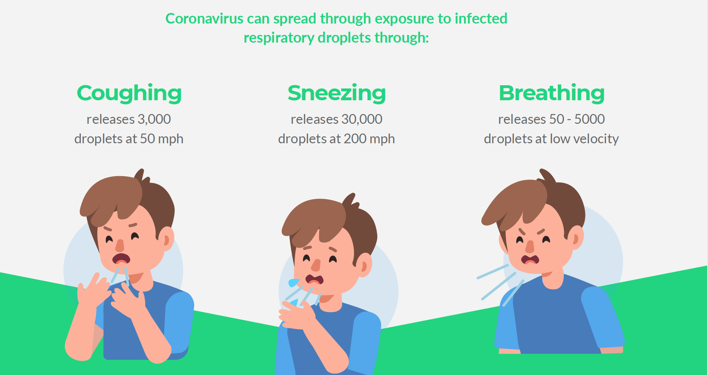
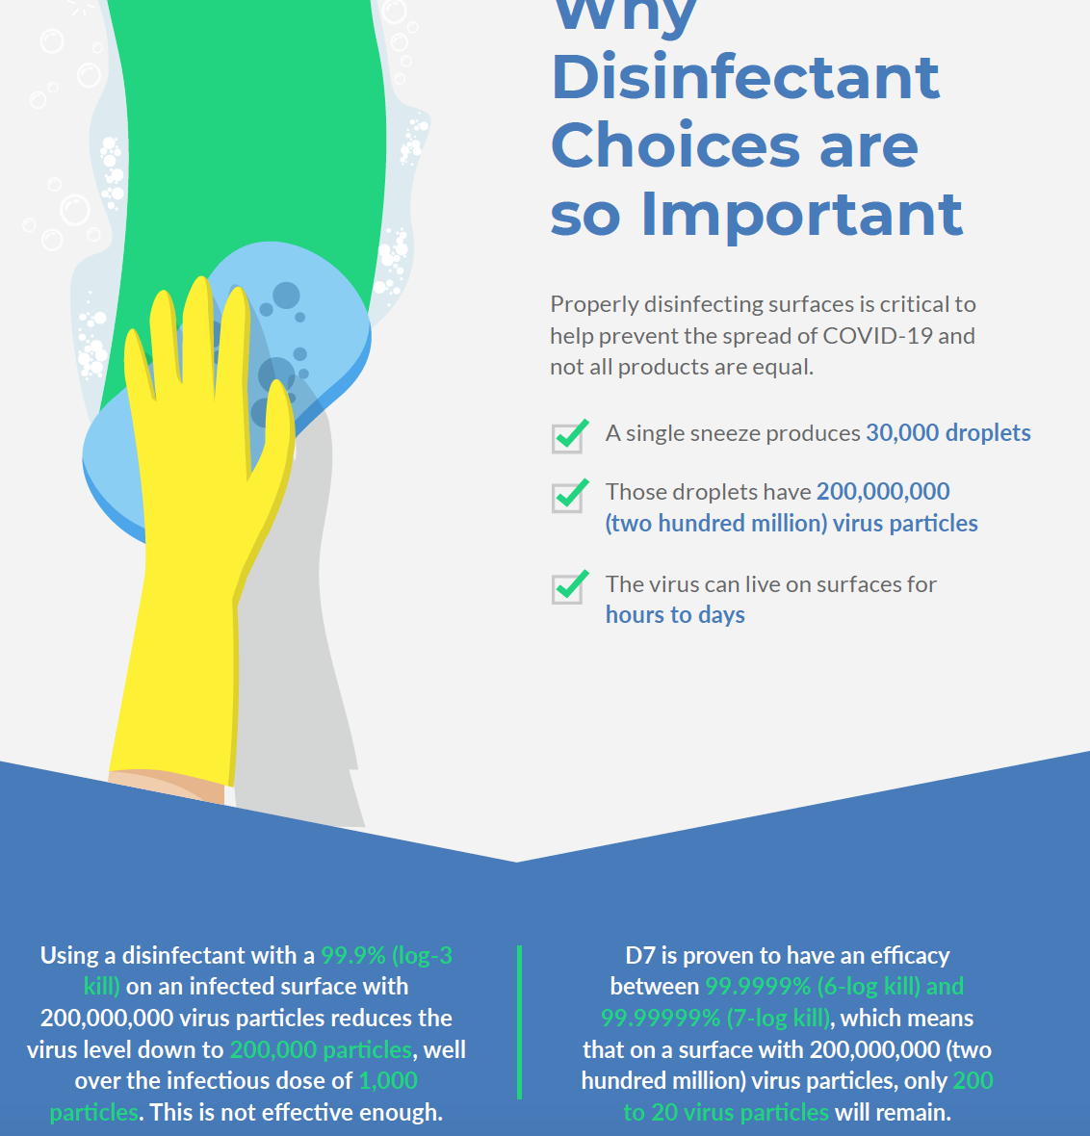
How Effective is Effective Enough?

Slide 7
EPA Label
EPA-approved label governs applications and directions for usage
Typically allows for different instructions re: Disinfecting, Sanitizing, and Deodorizing
Dilution allowances are listed on the label if applicable
ALWAYS defer to the label for usage requirements

Slide 8
Residual Properties
The problem with Residual Claims….
Building Owner/Operators will be required to develop regular disinfection plans to protect occupants
EPA has not evaluated the efficacy of any products claiming long-lasting efficacy against viruses. Therefore, there are no EPA-registered products with label claims that they are effective against viruses over the course of hours to months (i.e., “residual” or “long lasting” efficacy claims).
https://www.epa.gov/coronavirus/there-anything-i-can-do-make-surfaces-resistant-sars-cov-2

Slide 9
Disinfectant Chemistry Comparison

Slide 10
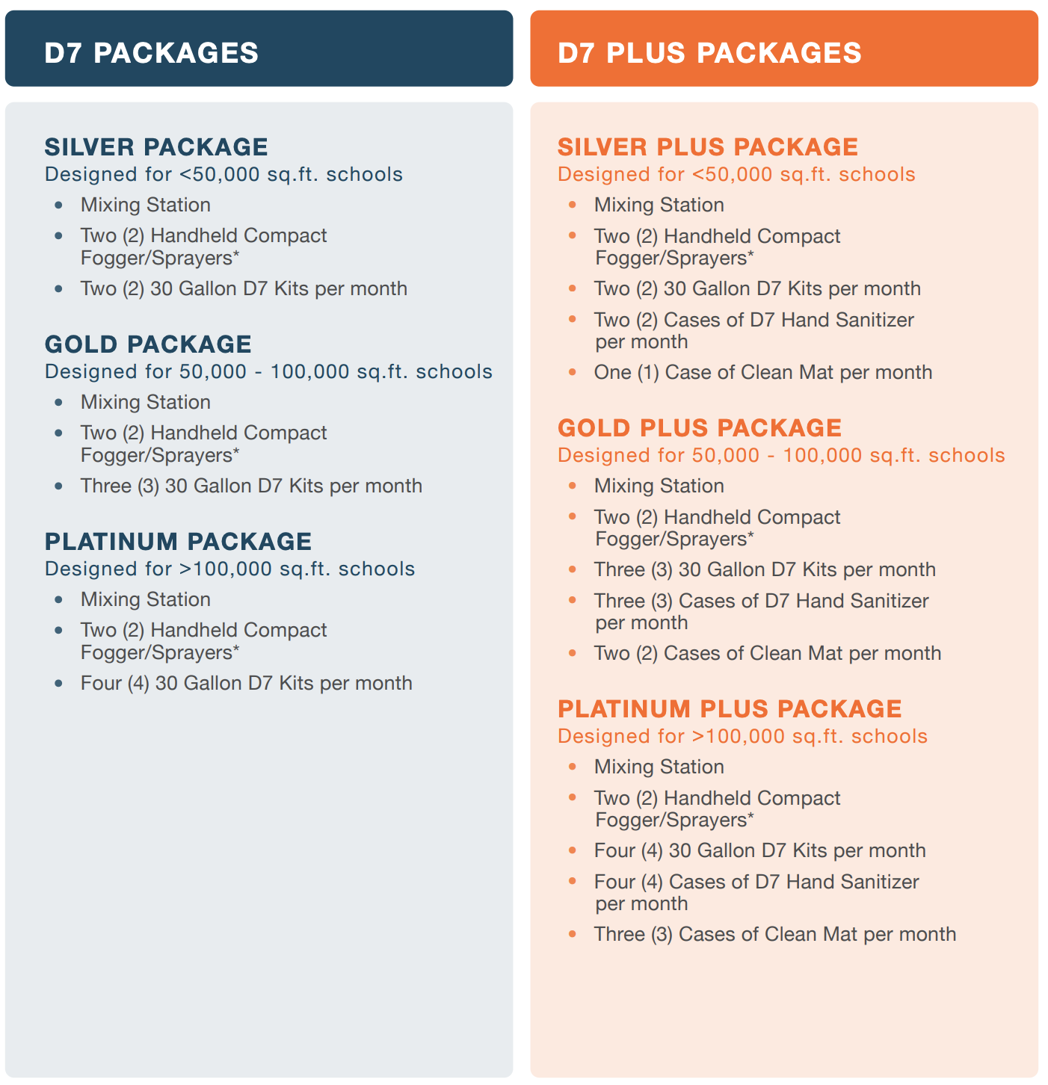
D7 Subscription Elements

Slide 11
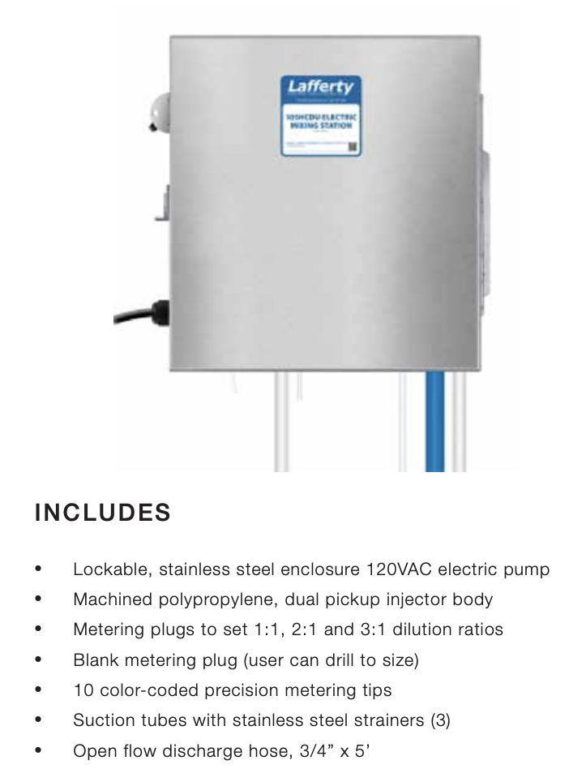
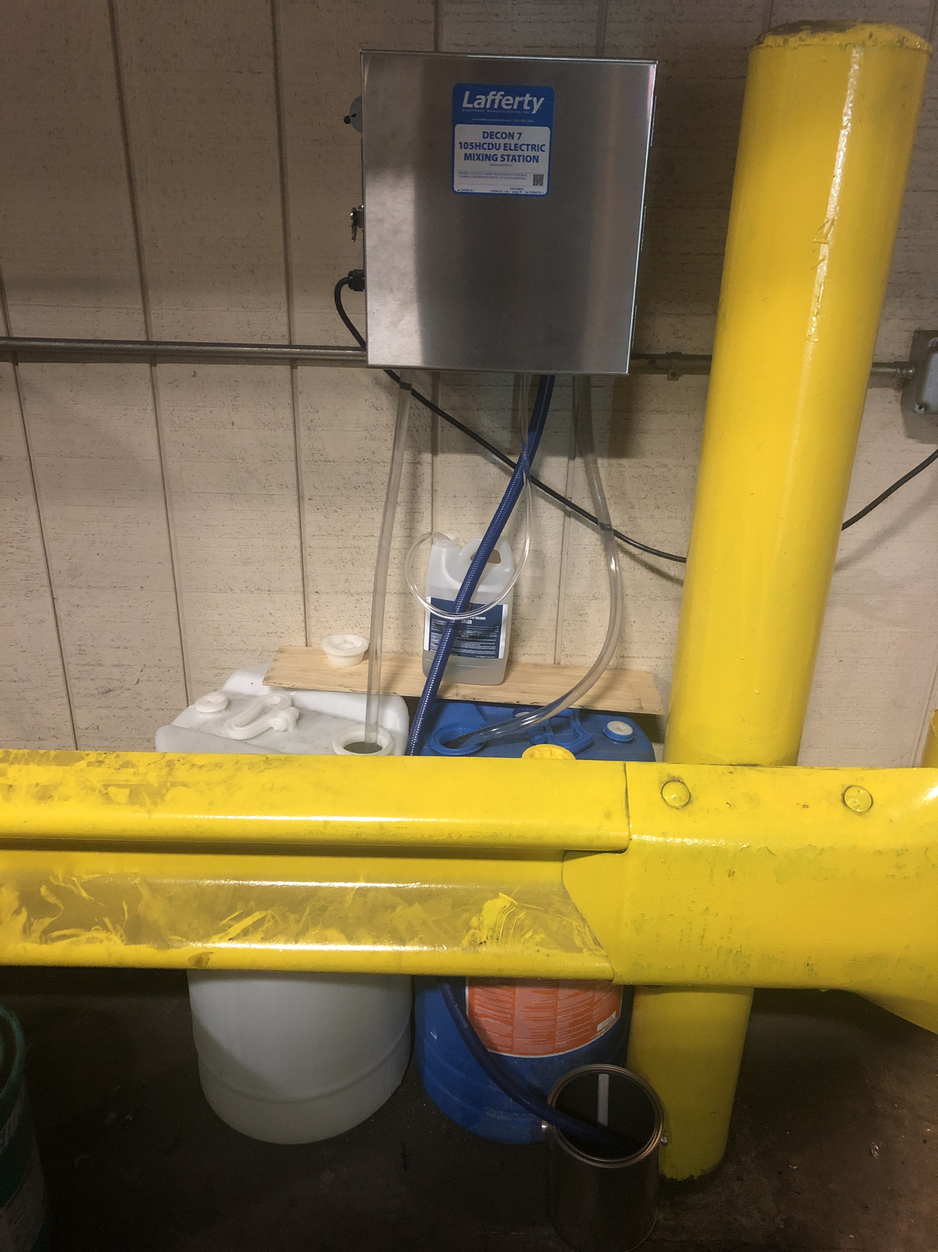
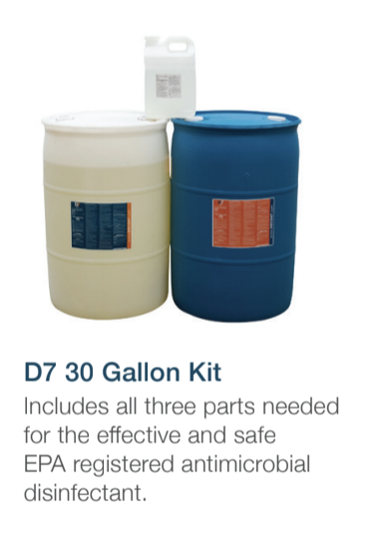
D7 30G Kits and Mixing Station

Slide 12
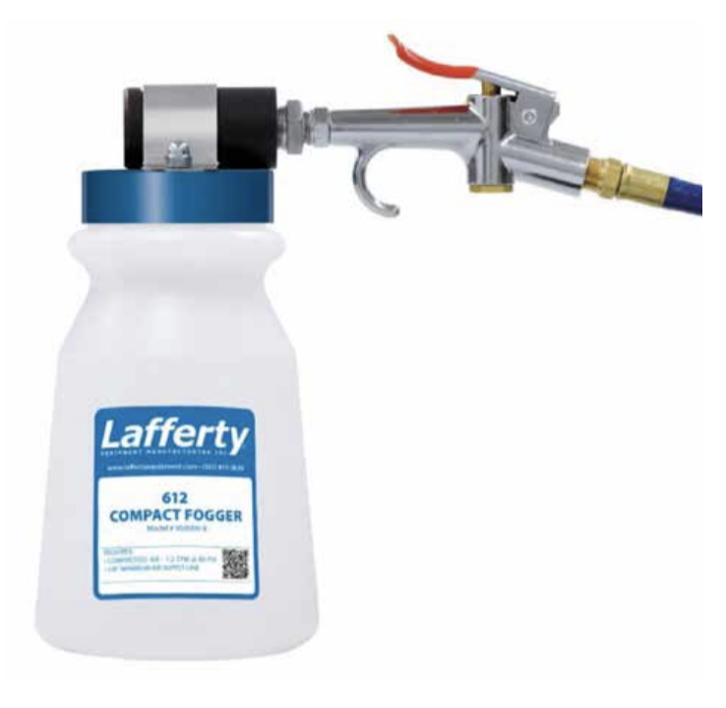
Compact Fogger / Sprayer
Small, ergonomically designed
Thumb trigger allows for efficient application
Fine mist does not require cleanup
Hooks up to a small air compressor

Slide 14
QUESTIONS?

